Slide 1
Computer Systems
Exercise Session 7

Slide 2
Chapter 15
Fault-Tolerance & Paxos

Slide 3
Terminology
Node
Client/Server
Client
Server

Slide 4
Client Server Model
C
Client
Server
Client sends command one at a time to the server

Slide 5
Fault-Tolerance
Various problems can occur in practice:
Messages may be lost
Nodes (client or server) may crash
Variable message transmission times
One fundamental goal: state replication
Same sequence of commands in the same order
First step to this: one command only
Task: make sure that all servers execute this same command

Slide 6
First approaches
Server sends acknowledgement message
Reasonable with one client
Choose one server as a Serializer
Single point of failure
Two-Phase Protocol and variants
How to handle server crashes?
How to avoid deadlock with locks?
Notes:
inconsistent state with multiple clients and servers.

Slide 7
Client-Server
A
Client
Server
Send and wait for ack

Slide 8
Client-Server
Servers
C
C
C
C
Client

Slide 9
Client-Server
Servers
A
A
Client
A
A

Slide 10
Client Server Model
0
+1
+1
0
*2
*2
Clients
Servers

Slide 11
Client Server Model
1
+1
+1
0
*2
*2
Clients
Servers

Slide 12
Client Server Model
2
1
Clients
Servers

Slide 13
Fault-Tolerance – State Replication
One fundamental goal: state replication
Same sequence of commands in the same order
First step to this: one command only
Task: make sure that all servers execute this same command

Slide 14
First Approach for State Replication
Server sends acknowledgement message
Reasonable with one client
Inconsistent state with multiple clients and servers
Choose one server as a Serializer (Master-slave replication)

Slide 15
Master Slave Replication
Servers
Clients
C
C
C
C
C
C
Server-Serializer

Slide 16
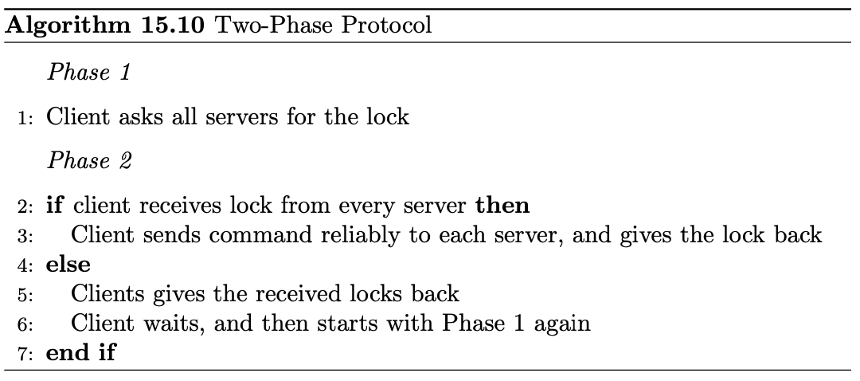
Two-Phase Protocol
What if node fails here!

Slide 17
First Approach for State Replication
Server sends acknowledgement message
Reasonable with one client
Inconsistent state with multiple clients and servers
Choose one server as a Serializer (Master-slave replication)
Single point of failure
Two-Phase Protocol and variants
Not well-defined if exceptions happen

Slide 18
Main steps of Paxos
Clients asks for a specific ticket t
Server only issues ticket t if t is the largest ticket requested so far
If client receives majority of tickets, it proposes a command
When a server receives a proposal, if the ticket of the client is still valid, the server stores the command and notifies the client
If a majority of servers store the command, the client notifies all servers to execute the command

Slide 19
Paxos
Servers hand out tickets
”Weak lock”, which can be overwritten by a later ticket
Only requires the majority of servers to agree
Already ensures that there is at most one accepted command
Servers notify clients about their stored command
Client can then switch to supporting this stored command
A video explaining Paxos quite nicely with slightly different terminology
https://www.youtube.com/watch?v=d7nAGI_NZPk

Slide 20
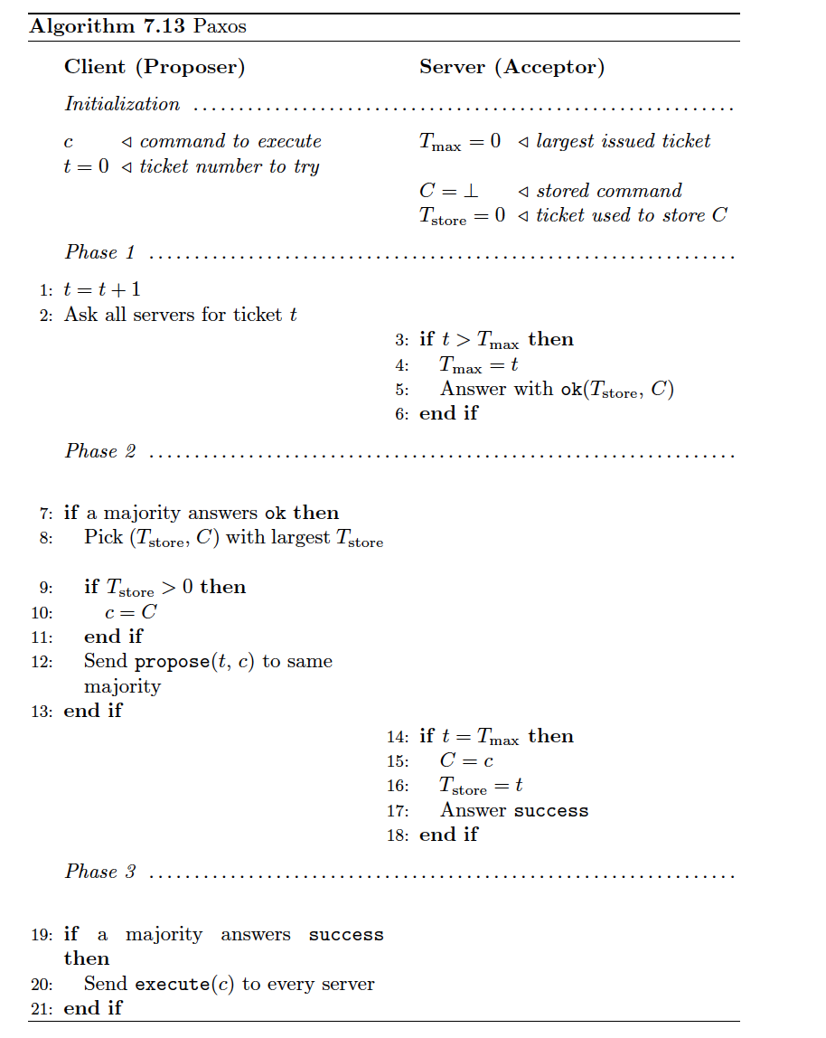
Clients asks for a specific ticket t
Server only issues ticket t if t is the largest ticket requested so far
If client receives majority of tickets, it proposes a command
When a server receives a proposal, if the ticket of the client is still valid, the server stores the command and notifies the client
If a majority of servers store the command, the client notifies all servers to execute the command

Slide 22
Paxos – Points to Remember
(1) Ask for ticket (2) Propose to majority (3) If propose successful, tell server to execute
Ticket numbers in proposals increase globally. A proposal can be uniquely identified by its ticket number.
Clients help each other by always proposing the newest command (highest ticket number).
Once a command has been stored on the majority, all proposals will be for that command.

Slide 25
Consensus
We want:
Agreement: all (correct) nodes decide for the same value
Termination: all (correct) nodes terminate
Validity: the decision value is the input value of at least one node
Impossibility:
Consensus cannot be solved deterministically in the asynchronous model.

Slide 26
Randomized Consensus
Easy cases:
All inputs are equal (all 0 or 1)
Almost all input values equal
Otherwise:
Choose a random value locally. → expected time O(2^n) until all agree (once)
Wouldn’t it be useful if the nodes could all toss the same coin? → Shared Coin.

Slide 27
Last Exercise
Assignment 6: Virtual Machines, Network Stack

Slide 28
Last Exercise
Every resource that must be protected from untrusted applications (VM’s):
CPU
MMU
Devices
Network
Use of VM’s:
Server consolidation
performance/resource isolation
cloud computing
backwards compatibility
debugging

Slide 29
Last Exercise
Type 1
Type 2
For laptop: Type 2, because you still want to be able to use your native OS.
For data center: Type 1, since it runs faster and there is no need for native OS.
Guest operating system
Guest operating system
Guest operating system
Guest operating system
App
App
App
App
App
App
App
App
Hypervisor
Hypervisor
Native OS
Real hardware
Real hardware

Slide 30
Last Exercise
Differences:
Paravirtualized OS knows it runs as a VM, fully virtualized OS does not know.
Advantages of paravirtualization:
runs more efficiently
Disadvantages of paravirtualization:
GuestOS needs to be modified
Problem it tries to solve:
managing amount of memory assigned to each VM
How does it do it:
Balloon driver gets installed in every VM. To reclaim memory from VM, balloon gets “inflated”, so balloon driver requests memory from VM. To give memory to VM, balloon gets “deflated”.

Slide 31
Last Exercise
Multiplexing: Different applications want to send packets, so the NIC queue has to be multiplexed between applications.
Demultiplexing: When a packet gets received, it will be demultiplexed to one of the receive queues.
Either accept unbounded number of connections and potentially run out of memory, or accept only a limited number of connections and potentially be vulnerable to DoS attacks.
Receive side scaling uses a hash function to figure out to which core a flow should be steered (can be implemented in hardware), while flow steering uses a table that assigns flows to cores. This is usually implemented in software.

Slide 32
Last Exercise
The hardware architecture might be such that some cores are not on the same computing node as the incoming data, assigning flow to those will increase latency and hurt performance
For each packet, the space that is needed for header etc. has to be known in advance, which is difficult. Just allocating the maximal size leads to a bad memory utilization.

Slide 33
Last Exercise
100 Gbit/s = 13421772800 bytes/s. With packet size of 1536 bytes, this results in 8’738’133.33 packets per second. So per packet, the processor has 1/ 8’738’133.33s which is 114.44 nanoseconds per packet.
a 3GHz processor executes 3 cycles per nanosecond. We need 1800 cycles per packet, which is 600 ns. From this we can conclude that we need 600/114.4 = 5.24 CPU ~ 6 CPU cores to handle that load.

