Slide 1
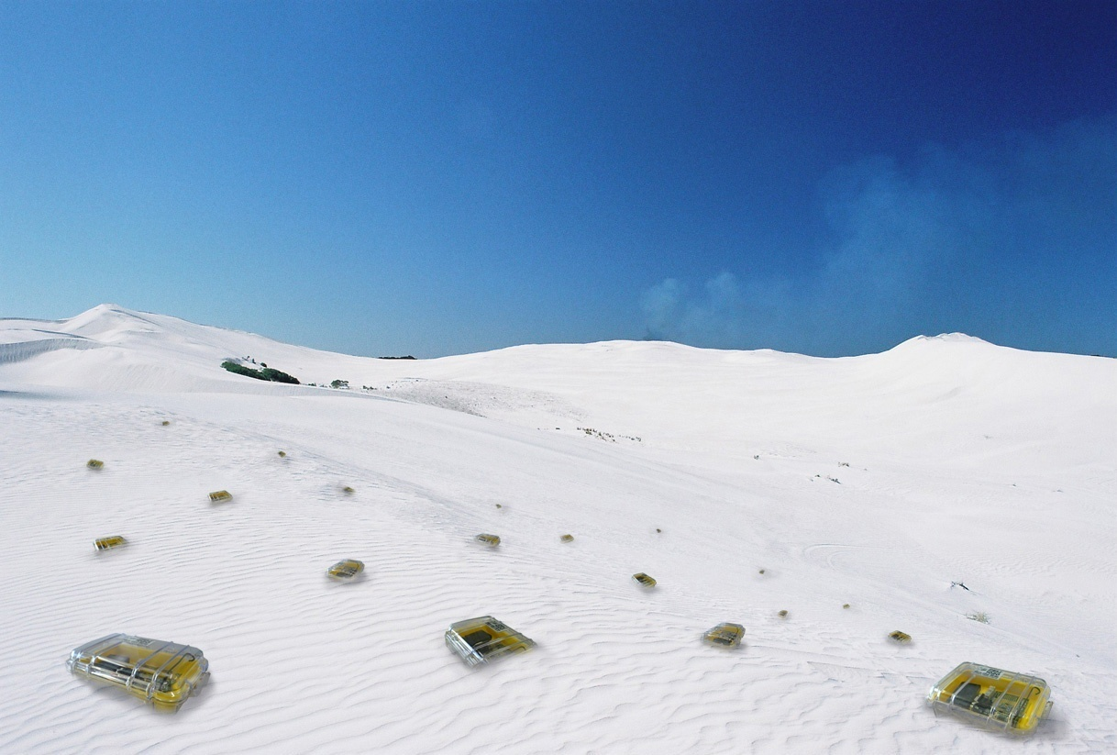

Network Coding
Chapter 5
TexPoint fonts used in EMF.
Read the TexPoint manual before you delete this box.: AAAAAAAA

Slide 2
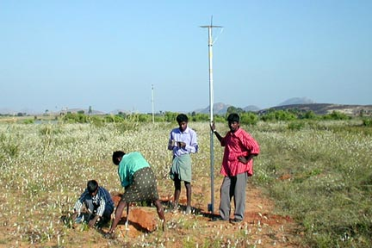
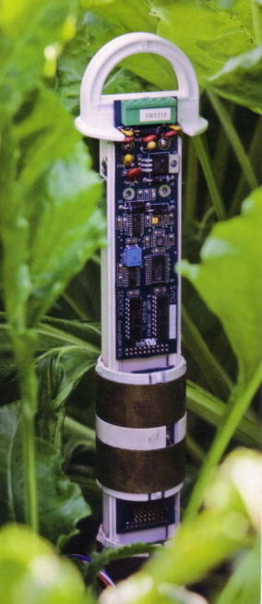
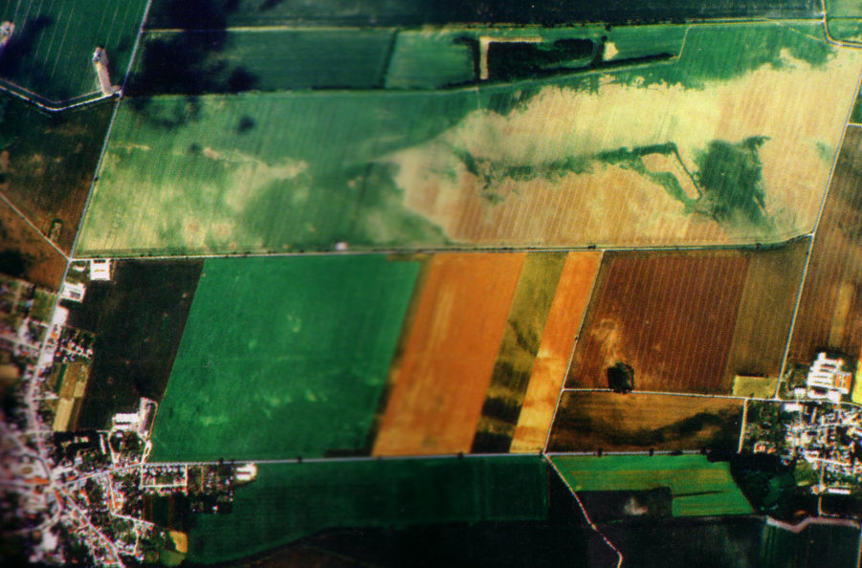
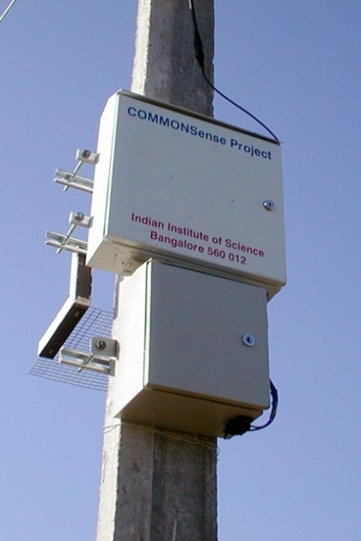

Agriculture (precision farming)
Farming decision support
system based on recent
local environmental data
  High accuracy: GPS tractors
  Irrigation, fertilization, pest control, etc. are output of function of sunlight, temp., humidity, soil moisture, etc.
[Technology Review, EPFL, IIT]

Slide 3
Rating
Area maturity
Practical importance
Theory appeal
First steps Text book
No apps Mission critical
Boooooooring Exciting

Slide 4
Overview
Motivation
Some bounds
Examples
Case Study: Data Gathering
  Self-coding
    Excursion: Shallow Light Tree
  Foreign coding
  Multi-coding

Slide 5
Motivation
Given the wireless network as below, where two nodes A and C are too far away to communicate directly. If transmitting one packet costs 1 time unit, how many time units do we need to transmit one packet from A to C and one packet from C to A?
Traditionally, intermediate nodes in networks just forward data. Network coding deviates from this paradigm, in the sense that intermediate nodes are allowed to process data before forwarding!
A
A
B
C
B
C

Slide 6
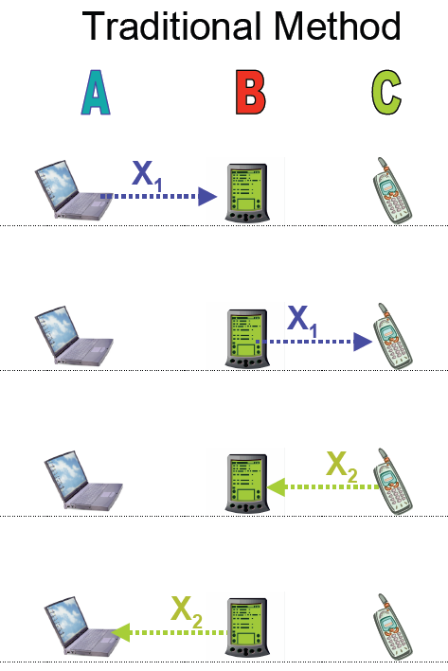
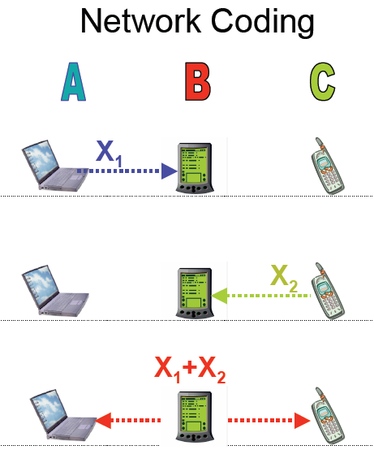
Network Coding Saves Transmissions
[Christina Fragouli, EPFL]

Slide 7
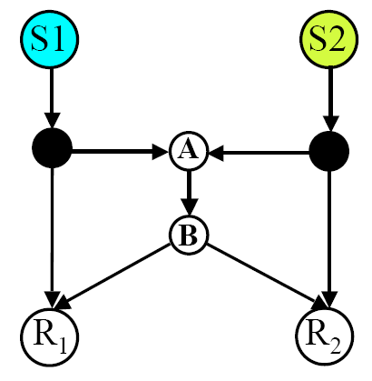
The Classic Example
Given two sources, each with a 1 GB file, and two receivers.
Each directed (wire-line!) link can forward 1 MB/s.
How long does it take until both receivers have received both files?

Slide 8
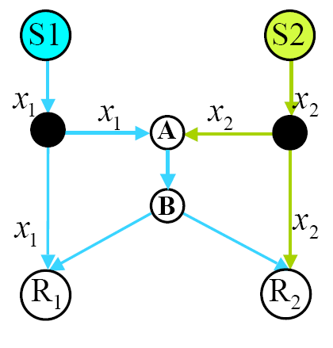
Without Network Coding?
Well, the naïve solution would first deliver the first file to both receivers, then the second. The total time needed is 2000s.
Can we do better (without network coding)?
First it seems that there is a better
“forwarding-only” solution. The
picture shows that we can deliver
a total of 3MB/s. However, this is
not true. Indeed “crossing” traffic
must go through the bottleneck
link A-B; to deliver the 2GB infor-
mation through this 1MB/s link,
we need 2000s…
What about with network coding?
[Christina Fragouli, EPFL]

Slide 9
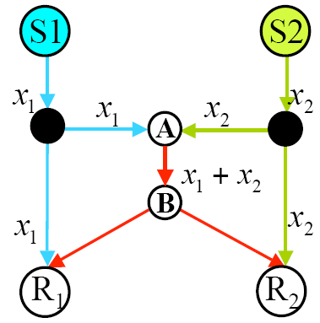
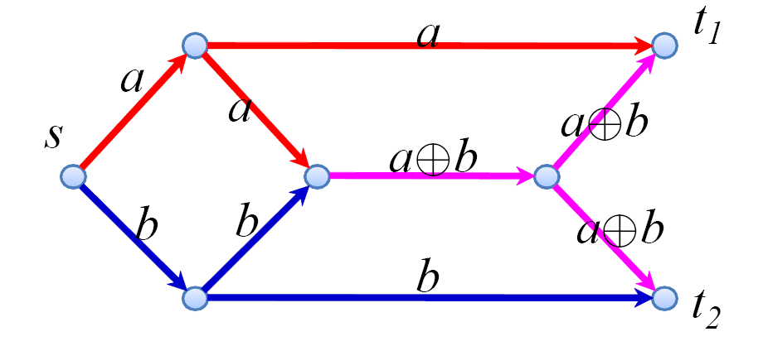
With Network Coding
With network coding, we can indeed deliver all the data in 1000s. Simply let the bottleneck link transmit the XOR of the two packets (or bits), and reconstruct everything at the receivers.
Network coding saves a
factor 2! In this example this is
optimal. In general?
BTW: Same example with one
source only is known better:
[Yunnan Wu]

Slide 10
Max-Flow Min-Cut Theorem [Ford-Fulkerson]
We can transmit a flow at rate r from source s to receiver t
Between source s and receiver t, the minimum cut is r
Assumes splittable flows
Can we achieve the max-flow min-cut
rate even when multicasting?!

Slide 11
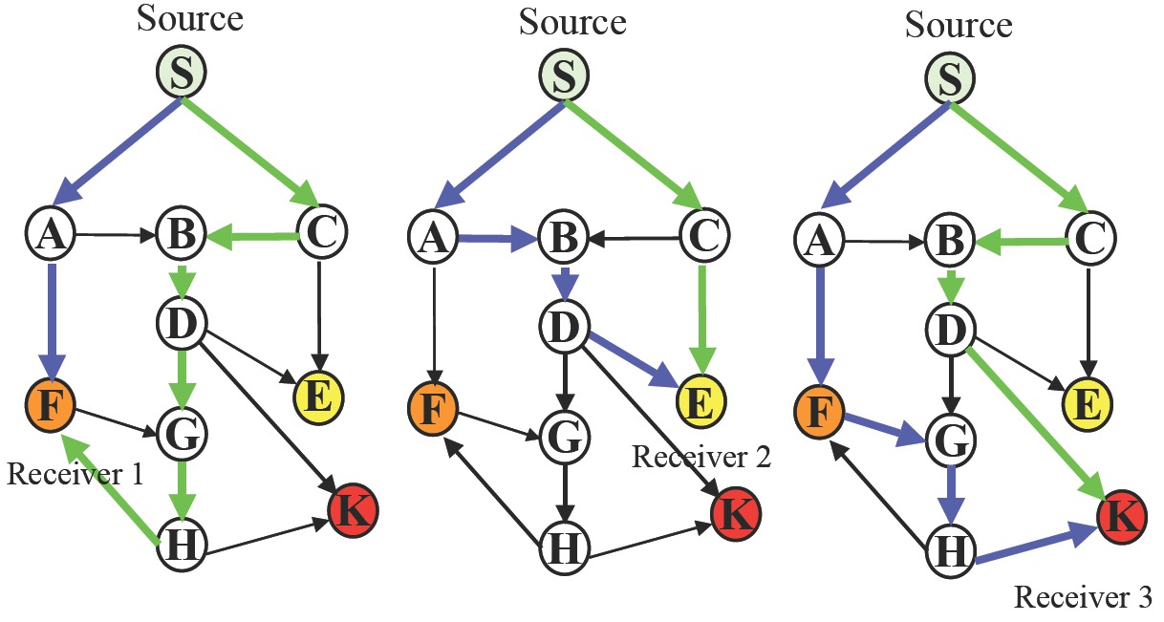
Multicasting
Consider a network, where the source S wants to multicast to three receivers E, F, and K. The min-cut between S and each individual receiver is 2. However, some edges (e.g. SA and BD) are used in conflicting ways! We have to make sure that green paths don’t share edges with blue paths…
[Christina Fragouli, EPFL]

Slide 12
Steiner Tree Packing
To optimize multicasting (without network coding), we need to solve the Steiner tree packing problem (How can you connect source and all destinations by edge-disjoint Steiner trees?). This is known to be notoriously difficult (NP-complete, there are approximations).
Even if we could solve this, we might end up with a solution which is inferior to the best solution using network coding.
  Indeed, all previous examples showed that the best Steiner tree packing is a factor 2 worse than the min-cut.

Slide 13
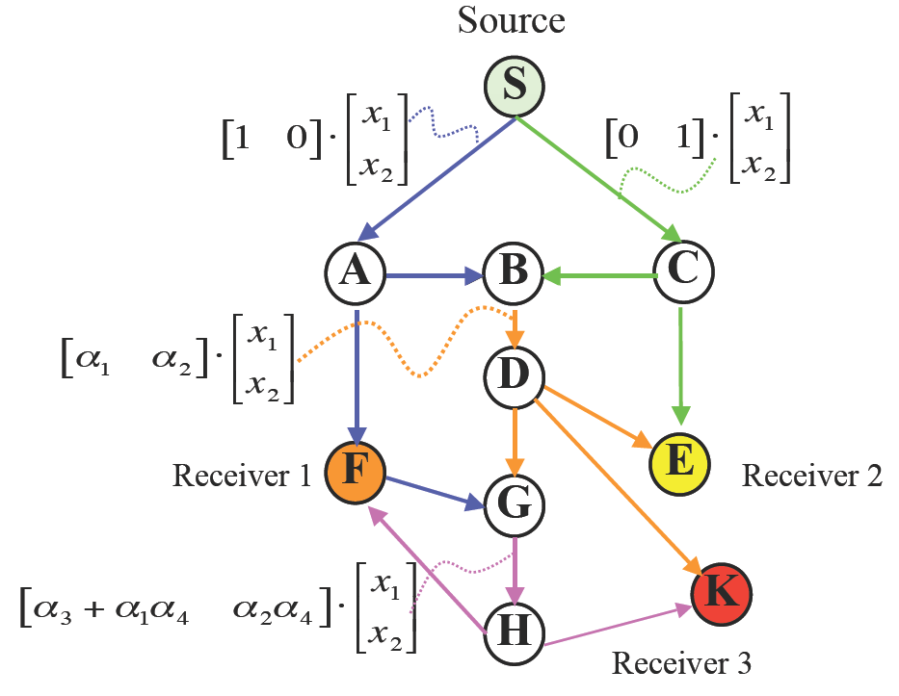
Multicasting w/ Network Coding [Ahlswede, Cai, Li, Yeung]
We can transmit a flow at rate r from source s to each receiver t_{i}
Between source s and each receiver t_{i}, the minimum cut is r
This works with various
coding schemes
Indeed, the factor 2 was no
coincidence. For undirected
networks, it can be shown
that network coding can at
most improve multicasting
by a factor 2.
[Christina Fragouli, EPFL]

Slide 14
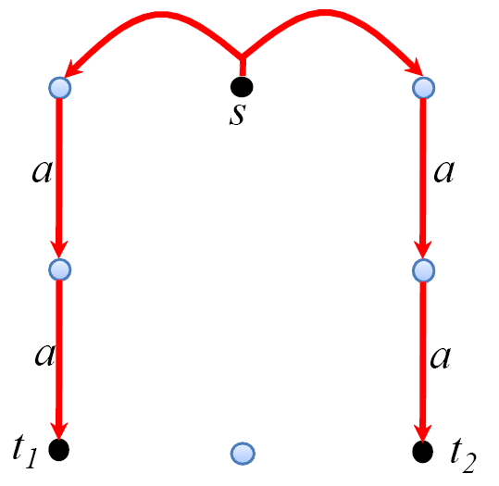
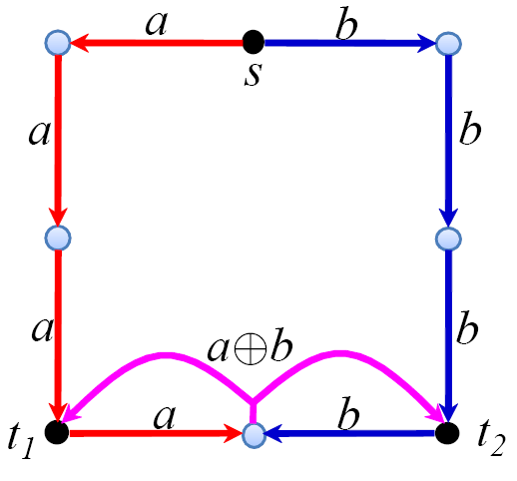
Multicast: Saving Transmissions?
Can we construct examples, where we can save transmissions?
Yes, for instance with 8 nodes, square topology:
[Yunnan Wu]

Slide 15
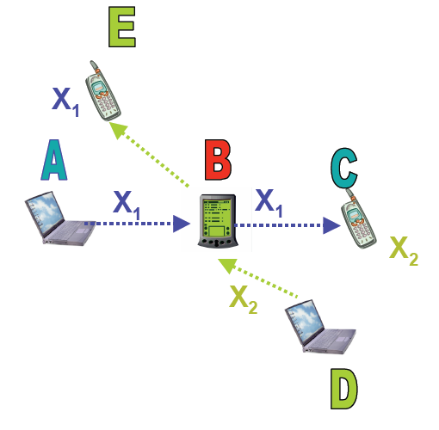

Applications: Network Bottlenecks
Node B in the network below is a “bottleneck” because it will need to forward traffic for two flows (A to C and D to E).
However, thanks to overhearing,
it is enough if B transmits the
XOR. In this example, all nodes
have the same amount of traffic.

Slide 16
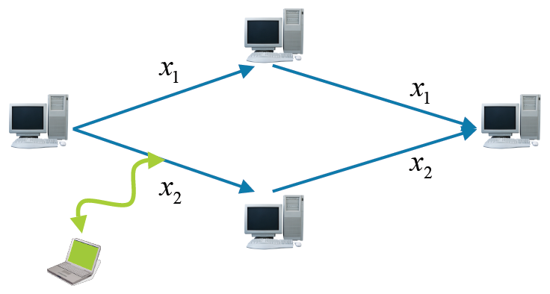
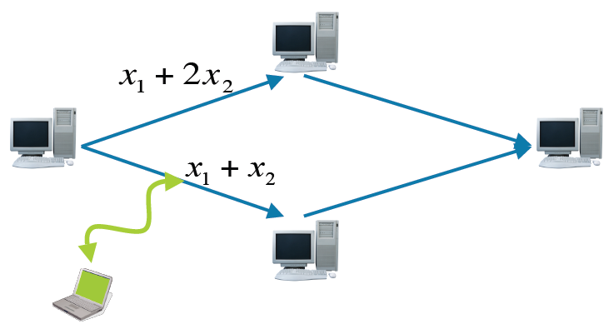
Applications: Security
[Christina Fragouli, EPFL]
Without network coding, an eavesdropper may get half of the information.
With network coding, getting useful information is harder.

Slide 17
Digital Fountain
A “digital fountain” streams data continuously and consumers get the full content after a fixed number of received packets.
File
Transmission
Client 1
Client 2
+

Slide 18
Digital Fountain Discussion
With the right codes, arbitrary n + o(n) out of n packets are sufficient to reconstruct the complete file.
The digital fountain idea is slightly older than the other network coding applications, and may be seen as the original work on network coding.
  However, in both the digital fountain and the security examples, intermediate nodes simply forward the data, without modification. As such, it may be outside the new scope of network coding.
Digital fountains may also be used to make data more available. Indeed, in peer-to-peer networks, thanks to coding, data may be available long after the source died.

Slide 19
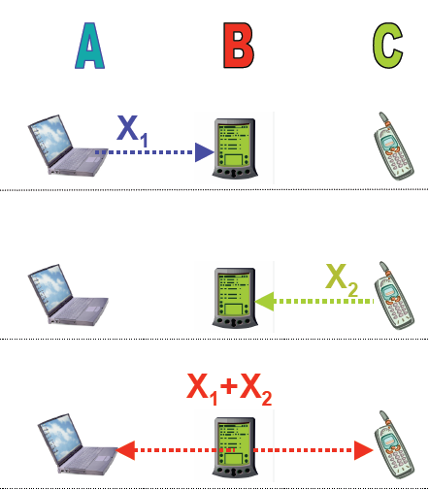
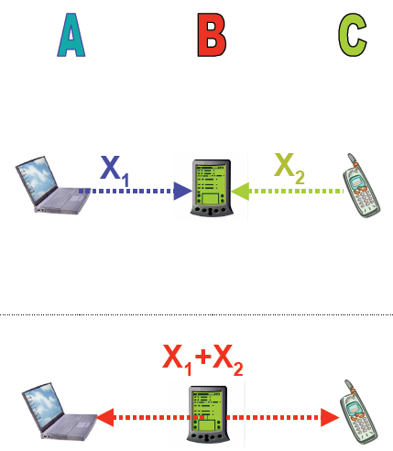
Physical Layer Network Coding
Remind 3-station example:
Instead, node B may just repeat the received physical signal, saving one more slot:
[Christina Fragouli, EPFL]

Slide 20











Case Study: Data Gathering (with Network Coding)
All nodes produce relevant information about their vicinity periodically.
Data is conveyed to an information sink for further processing.
Coding scheme
How do we minimize the amount of transmitted data?

Slide 21
Time coding
The simplest trick in the book: If the sensed data of a node changes not too often (e.g. temperature), the node only needs to send a new message when its data (significantly) changes.
Improvement: Only send change of data, not actual data.
similar to video codecs

Slide 22

Correlated Data
Different sensor nodes partially monitor the same spatial region.
Data might be processed as it is routed to the information sink.
Data correlation
Network coding
At which node is node u’s data encoded?
Find a routing scheme and a coding scheme to deliver data packets from all nodes to the sink such that the overall energy consumption is minimal.

Slide 23

Coding strategies
Multi-input coding
  Exploit correlation among several nodes.
  Combined aggregation of all incoming data.
Single-input coding
  Encoding of a nodes data only depends on the side information of one other node.
Recoding at intermediate nodes
Synchronous communication model
No recoding at intermediate nodes
No waiting for belated information at intermediate nodes

Slide 24
Single-input coding
Self-coding
  A node can only encode its raw data in the presence of side information.
Foreign coding
  A node can use its raw data to encode data it is relaying.
u
v
s_{r}
s_{r}
Encoded data size
w
Raw data size
2s_{r}+s_{e}
t
4s_{r}+ s_{e}
u
v
s_{r}
s_{r}
w
s_{r}+2s_{e}
t
3s_{r} + 2s_{e}

Slide 25
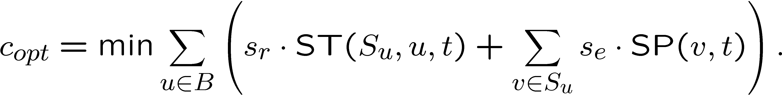
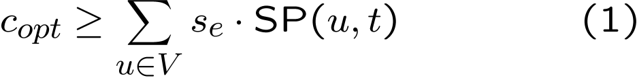
Self-coding
The cost of an optimal topology
Set of nodes that encode with data from u
Set of nodes with no side information
Shortest path
Steiner tree
Two ways to lower-bound this equation:

Slide 26
MST vs. SPT
Is a good SPT not automatically a good MST (or vice versa)?
MST SPT SLT
Is a good SPT not automatically a good MST (or vice versa)?

Slide 27
Excursion: Shallow-Light Tree (SLT)
Introduced by [Awerbuch, Baratz, Peleg, PODC 1990]
Improved by [Khuller, Raghavachari, Young, SODA 1993]
  new name: Light-Approximate-Shortest-Path-Tree (LAST)
Idea: Construct a spanning tree for a given root r that is both a MST-approximation as well as a SPT-approximation for the root r. In particular, for any γ > 0
Remember:
  MST: Easily computable with e.g. Prim’s greedy edge picking algorithm
  SPT: Easily computable with e.g. Dijkstra’s shortest path algorithm

Slide 28
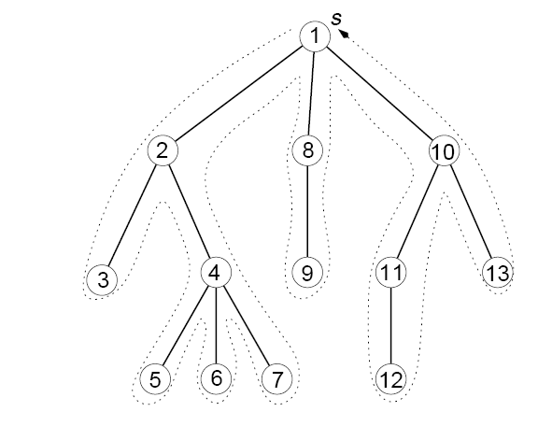
Result & Preordering
Main Theorem: Given an α > 1, the algorithm returns a tree T rooted at r such that all shortest paths from r to u in T have cost at most α the shortest path from r to u in the original graph (for all nodes u). Moreover the total cost of T is at most β = 1+2/(α-1) the cost of the MST.
We need an ingredient:
A preordering of a rooted
tree is generated when
ordering the nodes
of the tree as visited by
a depth-first search
algorithm.

Slide 29
The SLT Algorithm
Compute MST H of Graph G;
Compute all shortest paths (SPT) from the root r.
Compute preordering of MST with root r.
For all nodes v in order of their preordering do
  Compute shortest path from r to v in H. If the cost of this shortest path in H is more than a factor α more than the cost of the shortest path in G, then just add the shortest path in G to H.
  Formally: IF d_{H}(r,z_{i}) > αd_{G}(r,z_{i}) THEN H := H + d_{G}(r,z_{i}) ENDIF.
Now simply compute the SPT with root r in H.
Sounds crazy… but it works!

Slide 30
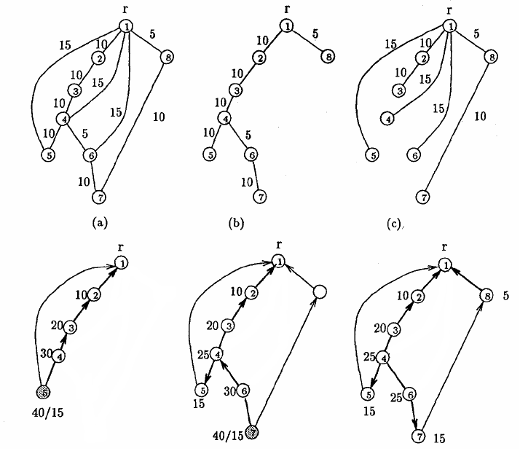
An example, α = 2
MST
SPT
Graph
x
x

Slide 31
Proof of Main Theorem
The SPT α-approximation is clearly given since we included all necessary paths during the construction and in step 5 only removed edges which were not in the SPT.
We need to show that our final tree is a β-approximation of the MST. In fact we show that the graph H before step 5 is already a β-approximation!
For this we need a little helper lemma first…

Slide 32
A preordering lemma
Lemma: Let T be a rooted spanning tree, with root r, and let z₀, z₁, …, z_{k} be arbitrary nodes of T in preorder. Then,
“Proof by picture”: Every edge
is traversed at most twice.
Remark: Exactly like the
2-approximation algorithm
for metric TSP.

Slide 33
Proof of Main Theorem (2)
Let z₁, z₂, …, z_{k} be the set of k nodes for which we added their shortest paths to the root r in the graph in step 4. In addition, let z₀ be the root r. The node z_{i} can only be in the set if (for example)
d_{G}(r,z_{i-1}) + d_{MST}(z_{i-1},z_{i}) > αd_{G}(r,z_{i}), since the shortest path (r,z_{i-1}) and the path on the MST (z_{i-1},z_{i}) are already in H when we consider z_{i}.
We can rewrite this as αd_{G}(r,z_{i}) - d_{G}(r,z_{i-1}) < d_{MST}(z_{i-1},z_{i}). Summing up:
αd_{G}(r,z₁) - d_{G}(r,z₀) < d_{MST}(z₀,z₁) (i=1)
αd_{G}(r,z₂) - d_{G}(r,z₁) < d_{MST}(z₁,z₂) (i=2)
… … …
αd_{G}(r,z_{k}) - d_{G}(r,z_{k-1}) < d_{MST}(z_{k-1},z_{k}) (i=k)
Σ_{i=1…k}(α-1) d_{G}(r,z_{i}) + αd_{G}(r,z_{k}) < Σ_{i=1…k} d_{MST}(z_{i-1},z_{i})

Slide 34
Proof of Main Theorem (3)
Simplifying a bit: (α-1) Σ_{i=1…k} d_{G}(r,z_{i}) < Σ_{i=1…k} d_{MST}(z_{i-1},z_{i})
All we did in our construction of H was to add exactly at most the cost Σ_{i=1…k} d_{G}(r,z_{i}) to the cost of the MST. In other words,
cost(H) · cost(MST) + Σ_{i=1…k} d_{G}(r,z_{i}).
Using the inequality at the top of this slide we have
cost(H) < cost(MST) + 1/(α-1) Σ_{i=1…k} d_{MST}(z_{i-1},z_{i}).
Using our preordering lemma we have
cost(H) · cost(MST) + 1/(α-1) 2cost(MST) = 1+2/(α-1) cost(MST)
That’s exactly what we needed: β = 1+2/(α-1).

Slide 35
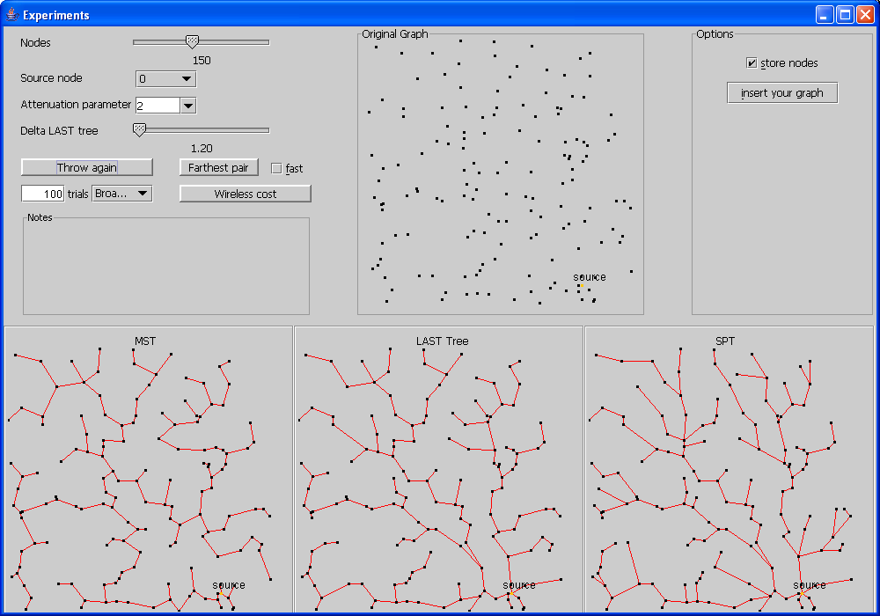
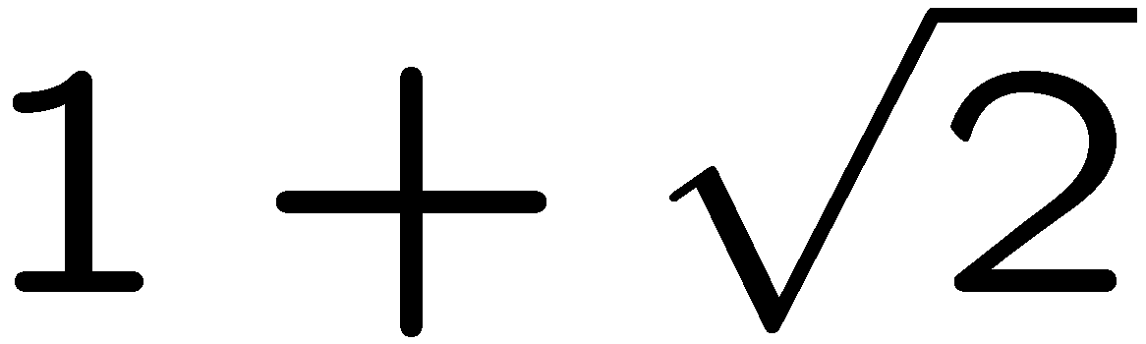
How the SLT can be used
The SLT has many applications in communication networks.
Essentially, it
bounds the
cost of unicasting
(using the SPT)
and broadcasting
(using the MST).
Remark: If you
use α = ,
then
β = 1+2/(α-1) = α.
[www.dia.unisa.it/~ventre]

Slide 36
Algorithm
LEGA (Low Energy Gathering Algorithm)
Based on the shallow light tree (SLT)
Compute SLT rooted at the sink t.
The sink t transmits its packet p_{t}
Upon reception of a data packet p_{j} at node v_{i}
  Encode p_{i} with p_{j} → p_{i}^{j}
  Transmit p_{i}^{j} to the sink t
  Transmit p_{i} to all children
Size = s_{r}
Size = s_{e}

Slide 37
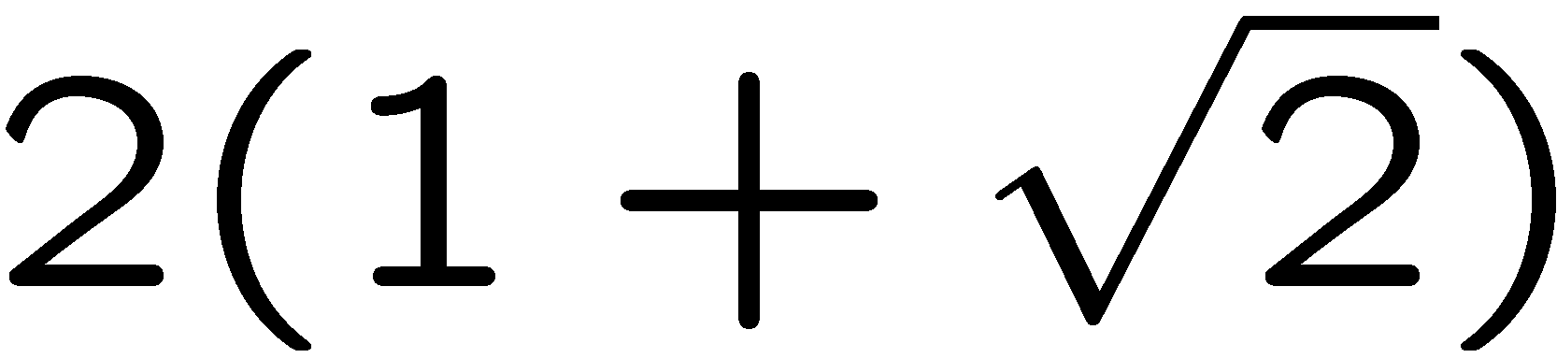

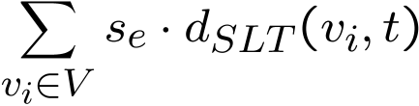
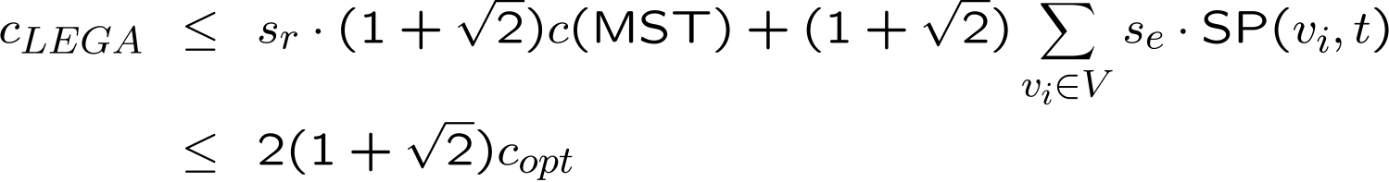
Analysis of LEGA
Theorem: LEGA achieves a -approximation of the optimal topology. (We use α = .)
t
t
Slide 5/25

Slide 38
Foreign coding
MEGA (Minimum-Energy Gathering Algorithm)
  Superposition of two tree constructions.
Compute the shortest path tree (SPT) rooted at t.
Compute a coding tree.
  Determine for each node u a corresponding encoding node v.
u
v
s_{r}
s_{r}
w
s_{r}+2s_{e}
Encoding must not result in cyclic dependencies.
t
Coding tree
SPT
u
u
v
v
t
t

Slide 39
Coding tree construction
Build complete directed graph
Weight of an edge e=(v_{i},v_{j}):
Cost from v_{j} to the sink t.
Cost from v_{i} to the encoding node v_{j}.
Number of bits when encoding v_{i}‘s info at v_{j}
Compute a directed minimum spanning tree (arborescence) of this graph. (This is not trivial, but possible.)
Theorem: MEGA computes a minimum-energy data gathering topology for the given network.
All costs are summarized in the edge weights of the directed graph.

Slide 40
Summary
Self-coding:
  The problem is NP-hard [Cristescu et al, INFOCOM 2004]
  LEGA uses the SLT and gives a -approximation.
  Attention: We assumed that the raw data resp. the encoded data always needs s_{r} resp. s_{e} bits (no matter how far the encoding data is!). This is quite unrealistic as correlation is usually regional.
Foreign coding
  The problem can be solved optimally, with MEGA.
What if we allow both coding strategies at the same time?
What about a more accurate correlation model?
What if multi-coding is allowed?

Slide 41
Multicoding
Hierarchical matching algorithm [Goel & Estrin SODA 2003].
We assume to have concave,
non-decreasing aggregation
functions. That is, to transmit
data from k sources, we need
f(k) bits with f(0)=0, f(k) ¸ f(k-1),
and f(k+1)/f(k) · f(k)/f(k-1).
The nodes of the network must be a metric space*, that is, the cost of sending a bit over edge (u,v) is c(u,v), with
  Non-negativity: c(u,v) ¸ 0
  Zero distance: c(u,u) = 0 (*we don’t need the identity of indescernibles)
  Symmetry: c(u,v) = c(v,u)
  Triangle inequality: c(u,w) · c(u,v) + c(v,w)
#bits
#nodes

Slide 42
The algorithm
Assume that the network is a complete graph, obeying the triangle inequality. If not, use the cost of the shortest path as the distance function, and we are fine.
Let S be the set of source nodes. Assume that S is a power of 2. (If not, simply add copies of the sink node until you hit the power of 2.) Now do the following:
Find a min-cost perfect matching in S. Put all the matching edges in the solution.
For each of the matching edges, remove one of the two nodes from S (throw a regular coin to choose which node).
If the set S still has more than one node, go back to step 1. Else connect the last remaining node with the sink.

Slide 43
The result
Theorem: For any concave, non-decreasing aggregation function f, and for [optimal] total cost C[*], the hierarchical matching algorithm guarantees
That is, the expectation of the worst cost overhead is logarithmically bounded by the number of sources.

Slide 44
Remarks
For specific concave, non-decreasing aggregation functions, there are simpler solutions.
  For f(x) = x the SPT is optimal.
  For f(x) = const (with the exception of f(0) = 0), the MST is optimal.
  For anything in between it seems that the SLT again is a good choice.
  For any a priori known f one can use a deterministic solution by [Chekuri, Khanna, and Naor, SODA 2001]
  If we only need to minimize the maximum expected ratio (instead of the expected maximum ratio), [Awerbuch and Azar, FOCS 1997] show how it works.
Again, sources are considered to aggregate equally well with other sources. A correlation model is needed to resemble the reality better.

Slide 45
Other work using coding
LEACH [Heinzelman et al. HICSS 2000]: randomized clustering with data aggregation at the clusterheads.
  Heuristic and simulation only.
  For provably good clustering, see chapter on clustering.
Correlated data gathering [Cristescu et al. INFOCOM 2004]:
  Coding with Slepian-Wolf
  Distance independent correlation among nodes.
  Encoding only at the producing node in presence of side information.
  Same model as LEGA: NP-hardness proof.

Slide 46
Open problem
Future applications incorporating network coding may not try to optimize network throughput but utilize other side effects. In
peer-to-peer networks for example, network coding is used to increase the longevity of a file inside the network.
  Concretely, so far peers store pieces of a file. If all peers storing a certain piece leave the network, the file cannot be reconstructed anymore. Instead, if peers store combinations of pieces, the file will be more available.
Goal: Find a new application that exploits the reliability aspect of network coding.

