Slide 1
Stable Matching with Evolving Preferences
Varun Kanade, Nikos Leonardos, Frédéric Magniez. APPROX/RANDOM 2016
Presented by: André Águas

Slide 2
Stable Matching with Evolving Preferences

Slide 3
Stable Matching with Evolving Preferences

Slide 4
n

Slide 8
Stable Matching with Evolving Preferences

Slide 9
Stable Matching with Evolving Preferences

Slide 10
$π_{X1}$= [Y3; Y2; Y1]
X1
Y1
X2
Y2
X3
Y3

Slide 11
Stable Matching with Evolving Preferences

Slide 12
Stable Matching with Evolving Preferences

Slide 13
X1
Y1
$π_{X1}$ = [Y3; Y2; Y1]
$π_{Y1}$ = [X3; X2; X1]
$π_{X2}$ = [Y3; Y2; Y1]
X2
Y2
$π_{Y2}$ = [X1; X2; X3]
X3
Y3
$π_{X3}$ = [Y1; Y2; Y3]
$π_{Y3}$ = [X1; X2; X3]

Slide 14
X1
Y1
$π_{X1}$ = [Y3; Y2; Y1]
X2
Y2
X3
Y3
$π_{Y3}$ = [X1; X2; X3]

Slide 15
Stable Matching with Evolving Preferences

Slide 16
Gale-Shapley Algorithm

Slide 17
X1
Y1
[Y3; Y2; Y1]
[X1; X2; X3]
X2
Y2
[Y3; Y1; Y2]
[X2; X3; X1]
X3
Y3
[Y2; Y3; Y1]
[X3; X2; X1]

Slide 18
X1
Y1
[Y3; Y2; Y1]
[X1; X2; X3]
X2
Y2
[Y3; Y1; Y2]
[X2; X3; X1]
X3
Y3
[Y2; Y3; Y1]
[X3; X2; X1]

Slide 19
X1
Y1
[Y3; Y2; Y1]
[X1; X2; X3]
X2
Y2
[Y3; Y1; Y2]
[X2; X3; X1]
X3
Y3
[Y2; Y3; Y1]
[X3; X2; X1]
Y3

Slide 20
X1
Y1
[Y2; Y1]
[X1; X2; X3]
X2
Y2
[Y3; Y1; Y2]
[X2; X3; X1]
X3
Y3
[Y2; Y3; Y1]
[X3; X2; X1]
Y3

Slide 21
X1
Y1
[Y2; Y1]
[X1; X2; X3]
X2
Y2
[Y3; Y1; Y2]
[X2; X3; X1]
X3
Y3
[Y2; Y3; Y1]
[X3; X2; X1]
Y3

Slide 22
X1
Y1
[Y2; Y1]
[X1; X2; X3]
X2
Y2
[Y3; Y1; Y2]
[X2; X3; X1]
X3
Y3
[Y2; Y3; Y1]
[X3; X2; X1]
Y3
Y2

Slide 23
X1
Y1
[Y2; Y1]
[X1; X2; X3]
X2
Y2
[Y3; Y1; Y2]
[X2; X3; X1]
X3
Y3
[Y3; Y1]
[X3; X2; X1]
Y3
Y2

Slide 24
X1
Y1
[Y2; Y1]
[X1; X2; X3]
X2
Y2
[Y3; Y1; Y2]
[X2; X3; X1]
X3
Y3
[Y3; Y1]
[X3; X2; X1]
Y3
Y2

Slide 25
X1
Y1
[Y2; Y1]
[X1; X2; X3]
X2
Y2
[Y3; Y1; Y2]
[X2; X3; X1]
X3
Y3
[Y3; Y1]
[X3; X2; X1]
Y3
Y2
Y3

Slide 26
X1
Y1
[Y2; Y1]
[X1; X2; X3]
X2
Y2
[Y1; Y2]
[X2; X3; X1]
X3
Y3
[Y3; Y1]
[X3; X2; X1]
Y3
Y2
Y3

Slide 27
X1
Y1
[Y2; Y1]
[X1; X2; X3]
X2
Y2
[Y1; Y2]
[X2; X3; X1]
X3
Y3
[Y3; Y1]
[X3; X2; X1]
Y3
Y2
Y3

Slide 28
X1
Y1
[Y2; Y1]
[X1; X2; X3]
X2
Y2
[Y1; Y2]
[X2; X3; X1]
X3
Y3
[Y3; Y1]
[X3; X2; X1]
Y3
Y2
Y3
Y2

Slide 29
X1
Y1
[Y2; Y1]
[X1; X2; X3]
X2
Y2
[Y1; Y2]
[X2; X3; X1]
X3
Y3
[Y3; Y1]
[X3; X2; X1]
Y3
Y2
Y3
Y2

Slide 30
X1
Y1
[Y1]
[X1; X2; X3]
X2
Y2
[Y1; Y2]
[X2; X3; X1]
X3
Y3
[Y3; Y1]
[X3; X2; X1]
Y3
Y2
Y3
Y2

Slide 31
X1
Y1
[Y1]
[X1; X2; X3]
X2
Y2
[Y1; Y2]
[X2; X3; X1]
X3
Y3
[Y3; Y1]
[X3; X2; X1]
Y3
Y2
Y3
Y2
Y1

Slide 32
Once a woman becomes matched she never becomes unmatched again
X1
Y1
[]
[X1; X2; X3]
X2
Y2
[Y1; Y2]
[X2; X3; X1]
X3
Y3
[Y3; Y1]
[X3; X2; X1]
Y3
Y2
Y3
Y2
Y1

Slide 33
How many blocking pairs can a GS matching have in the worst case?

Slide 34
X1
Y1
X2
Y2
X3
Y3

Slide 35
Gale-Shapley always produces a matching with no blocking pairs (i.e. stable)

Slide 36
Stable Matching with Evolving Preferences

Slide 37
Stable Matching with Evolving Preferences

Slide 38
Evolving-data Model
Credit: Julian Steger

Slide 39
Website topic
Time of the day
Slot position
# clicks
# views
# hover time
# items bought
…
$U_{Company X}$(ETHZ) = f(attributes)

Slide 40
Property #1: pairwise swaps

Slide 41
a
b
c
d
e
f

Slide 42
a
b
c
d
e
f

Slide 43
a
b
d
c
e
f

Slide 44
Property #2: Access to data is done via Boolean queries

Slide 45
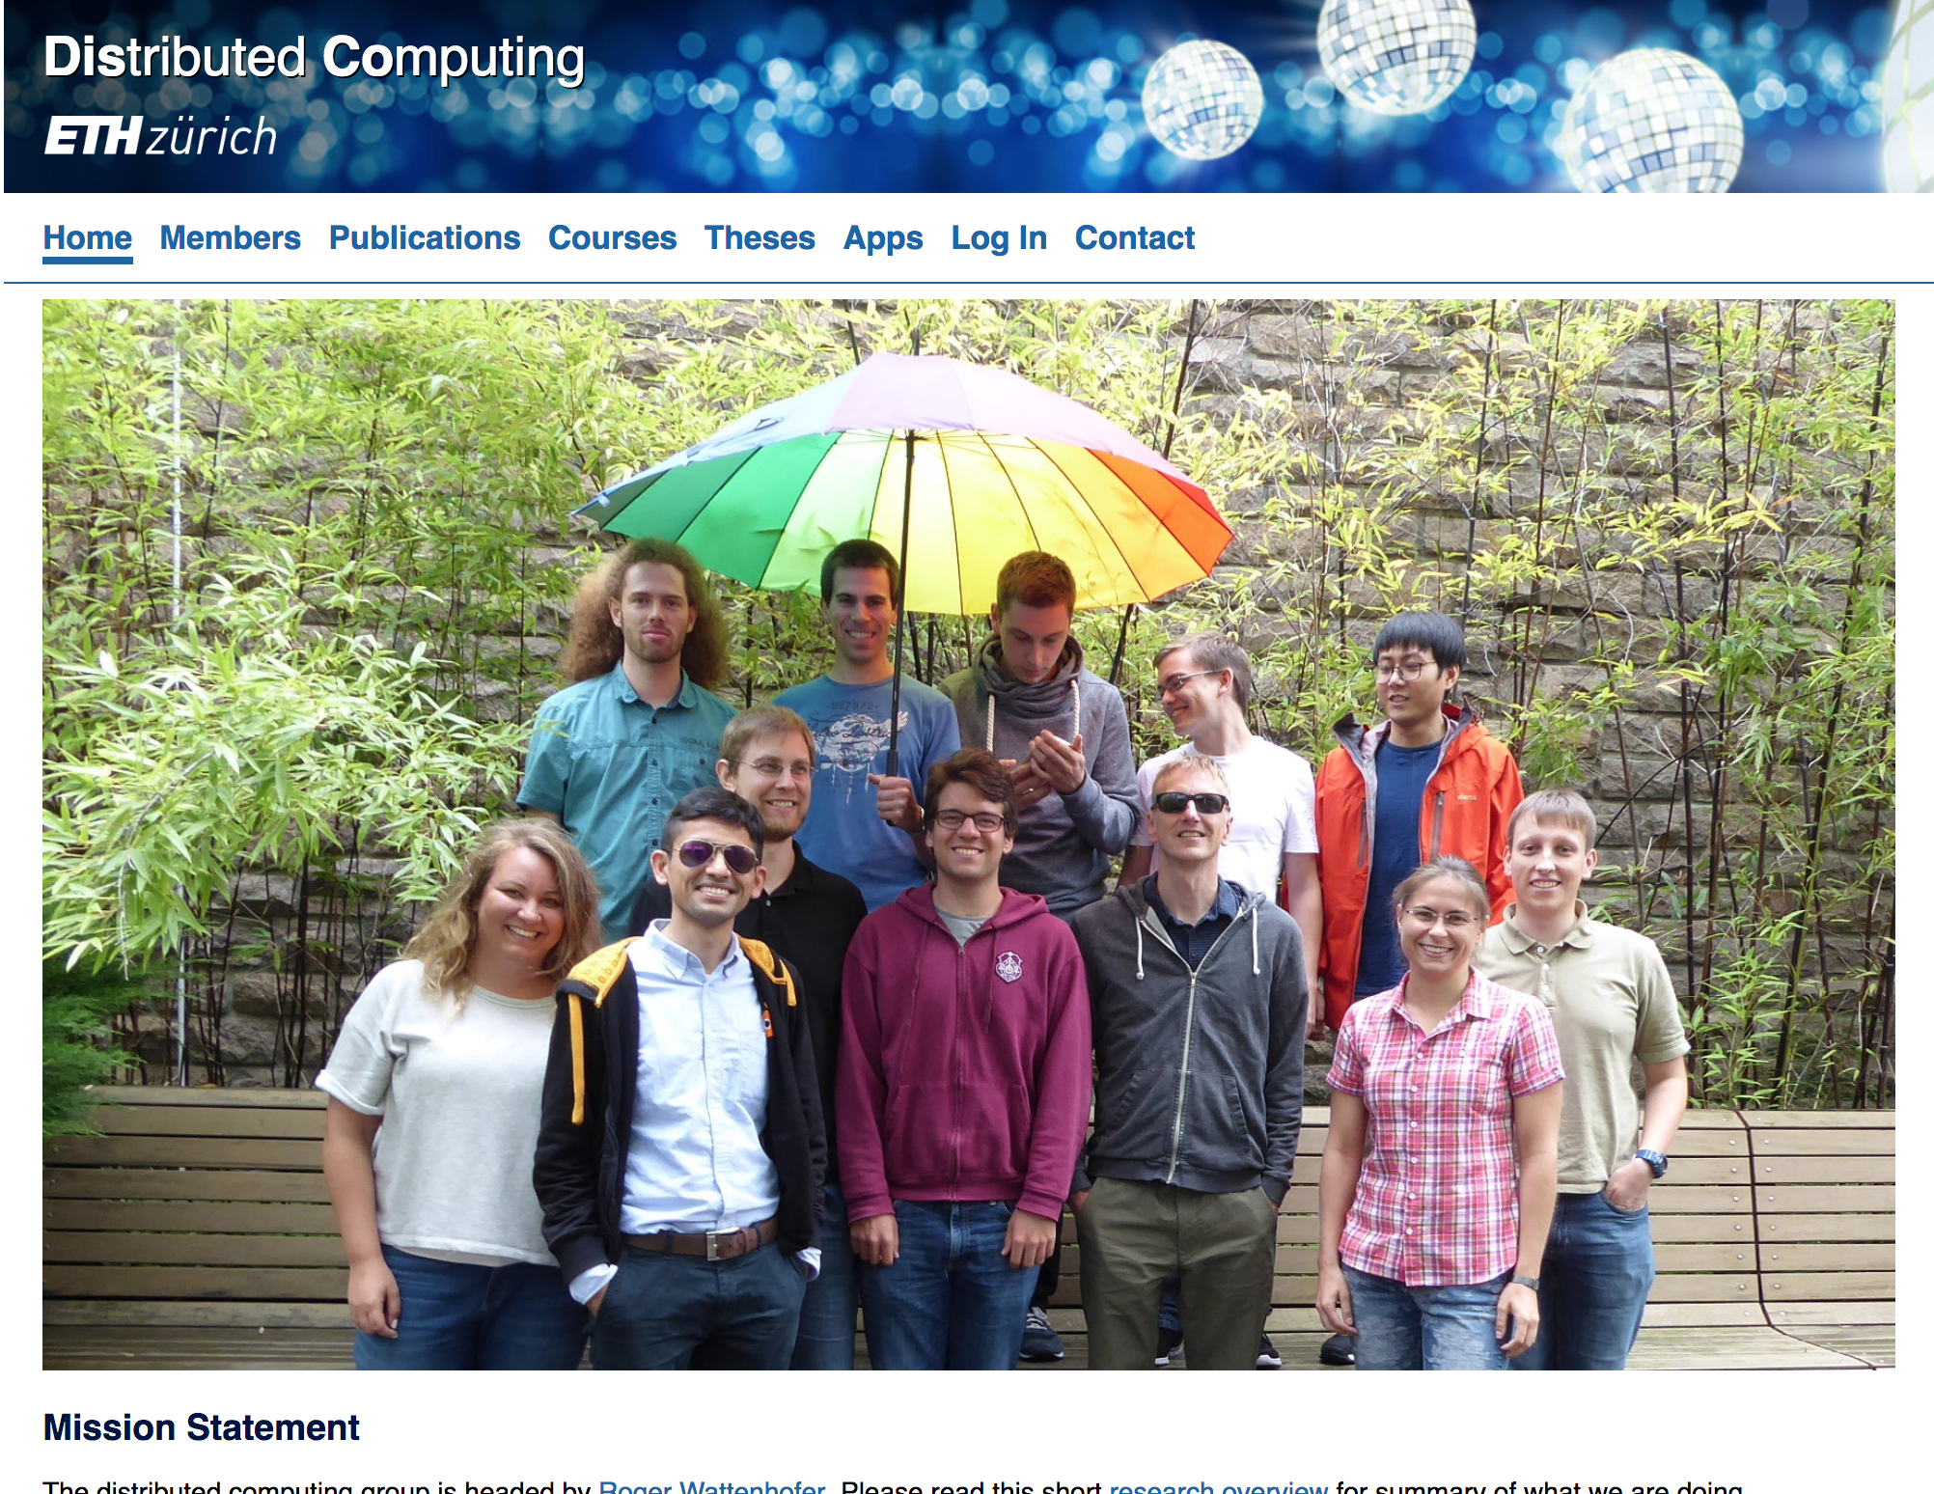
<

Slide 46
α swaps per query
Website topic
Time of the day
Slot position
# clicks
# views
# hover time
# items bought
…
$U_{Company X}$(ETHZ) = f(data)
<

Slide 47
Stable Matching with Evolving Preferences

Slide 48
X1
Y1
[Y3; Y2; Y1]
[X1; X2; X3]
X2
Y2
[Y3; Y1; Y2]
[X2; X3; X1]
X3
Y3
[Y2; Y3; Y1]
[X3; X2; X1]

Slide 49
Goal: minimize the number of blocking pairs

Slide 50
Everyone with me?

Slide 51
Results of the paper

Slide 52
A naïve algorithm

Slide 53
Sorting and selection on dynamic data
Aris Anagnostopoulos, Ravu Kummar, Mohammad Mahdian, Eli Upfal

Slide 54
Quicksort refresher

Slide 55
4
8
2
1
6
5

Slide 56
4
8
2
1
6
5

Slide 57
4
8
2
1
6
5

Slide 58
4
8
2
1
6
5

Slide 59
4
8
2
1
6
5

Slide 60
4
8
2
1
6
5

Slide 61
4
1
2
8
6
5

Slide 62
4
1
2
8
6
5

Slide 63
4
1
2
8
6
5

Slide 64
5
4
1
2
8
6

Slide 65
What is the running-time of Quicksort in the dynamic model?

Slide 66
1
2
3
4
5
6
Good pivot

Slide 67
Mistakes while sorting
$${\tilde{π}}_{z}$$
$$π_{z}$$

Slide 68
3
2
1
4
6
5

Slide 69
3
2
1
4
6
5

Slide 70
4
2
1
3
6
5

Slide 71
How can we count the number of mistakes?
Kendall 𝜏-distance

Slide 72
A
u
C
D
$$π_{z}$$
D
u
A
C
$${\tilde{π}}_{z}$$
$${KT}_{z}\left(u, v\right)=\left\{\begin{aligned}1, (u<_{{\tilde{π}}_{z}}v and v<_{π_{z}}u) or (u<_{π_{z}}v and v<_{{\tilde{π}}_{z}}u) \\ \\ 0, otherwise\end{aligned}\right.$$

Slide 73
At the completion of Quicksort, given an element u, how many pairs (u, v) do the permutations$π$and $\tilde{π}$rank differently?

Slide 74
4
2
1
3
6
5

Slide 75
$$𝔼\left[\#swaps of u\right]=$$
$$\frac{2}{n−1}$$
Pr[u is selected to swap]
.
# rounds
𝒪(n log n)
= 𝒪(log n)

Slide 76
$$\sum_{v}{{KT}_{z}(u, v)=𝒪(\log{n)}}$$

Slide 77
What is the sum of the KT distances, for an element u, after sorting 2n lists?

Slide 78
$$𝔼\left[\#swaps of u\right]=$$
$$\frac{2}{2n(n−1)}$$
.
Pr[u is selected to swap]
𝒪($n^{2}$log(n))
# iterations QS
= 𝒪(log n)

Slide 79
How many blocking pairs does the matching have?

Slide 80
U$\left(x, y\right)$: the pair (x, y) is blocking
$$I_{z}\left(w\right)=\left\{\begin{aligned}1, M(z)<_{{\tilde{π}}_{z}}v and v<_{π_{z}}M(z) \\ \\ 0, otherwise\end{aligned}\right.$$
U$\left(x, y\right)≤ I_{x}\left(y\right)+ I_{y}(x)$

Slide 81
$$\sum_{x,y}{\text{U}\left(x, y\right) }≤$$
$$\sum_{x}{\sum_{y}{I_{x}\left(y\right)} }$$
$$\sum_{y}{\sum_{x}{I_{y}\left(x\right)} }$$
+
=
$$\sum_{x}{𝒪(\log{n)}}$$
$$\sum_{y}{𝒪(\log{n)}}$$
=
+
=
=
$$𝒪(n log{n)}$$

Slide 82
Result:
When we finish computing the matching we have $𝒪(n\log{n)}$ blocking pairs

Slide 83
Match
Match
Match
…
Sort
Sort
Sort

Slide 84
$$𝔼\left[\#blocking pairs\right]=$$
$$\frac{2n}{2n\left(n−1\right)}$$
Pr[rank of M(z) decreases]
.
𝒪($n^{2}$log(n))
# iterations QS
= 𝒪(n log n)

Slide 85
Result:
The latest matching has $𝒪(n\log{n)}$ blocking pairs

Slide 86
One-sided evolution

Slide 87
Constant
Evolving
$π_{X1}$= [Y3; Y2; Y1]
X1
Y1
$π_{Y1}$ = [X3; X2; X1]
$π_{X2}$ = [Y1; Y2; Y3]
X2
Y2
$π_{Y2}$ = [X1; X2; X3]
X3
Y3
$π_{X3}$= [Y2; Y1; Y3]
$π_{Y3}$ = [X1; X2; X3]

Slide 89
How many blocking pairs does the matching have?

Slide 90
Constant
Evolving
$π_{X1}$= [Y3; Y2; Y1]
X1
Y1
$π_{Y1}$ = [X3; X2; X1]
$π_{X2}$ = [Y1; Y2; Y3]
X2
Y2
$π_{Y2}$ = [X1; X2; X3]
X3
Y3
$π_{X3}$= [Y2; Y1; Y3]
$π_{Y3}$ = [X1; X2; X3]

Slide 91
$$𝔼\left[\#blocking pairs\right]=$$
$$\frac{n}{n\left(n−1\right)}$$
.
Pr[rank of M(z) decreases]
𝒪($n\log{n)}$
# iterations GS
= 𝒪($\log{n)}$

Slide 92
Improved Algorithm

Slide 93
𝒪($n\log^{2}n$)
Match
Match
Match
…
Sort
Sort
Sort
…
𝒪$(n\log{n}$)

Slide 94
Gale-Shapley used in Naïve algorithm:
Now:

Slide 95
How many blocking pairs does the matching have?

Slide 96
$$𝔼\left[\#blocking pairs\right]=$$
$$\frac{1}{2n\left(n−1\right)}$$
.
Pr[rank of best decreases]
𝒪$(\log{n}$)
+
# iterations best
$$\frac{2n}{2n\left(n−1\right)}$$
.
Pr[rank of M(z) decreases]
# iterations GS
𝒪($n\log^{2}n$)
= 𝒪($\log^{2}n$)

Slide 97
Thank you !
Questions?

