Slide 1
Collaborative Filtering
Presentation by Alex Hugger

Slide 2

Filtering Documents

Slide 3
Content-Based Methods
Find other popular items by the same author or similar keywords
Recommendation quality is relatively poor

Slide 4

Filtering Music

Slide 5
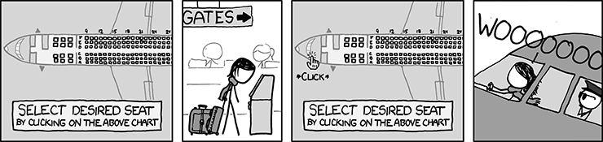
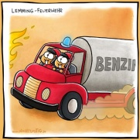
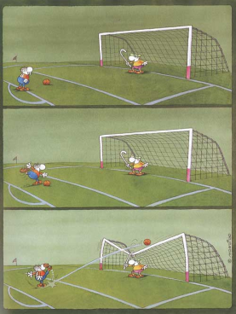
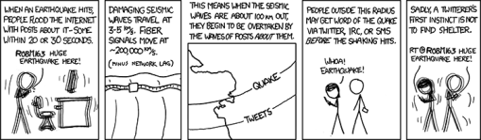
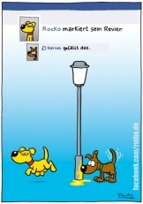
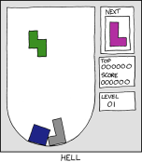
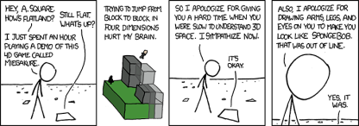
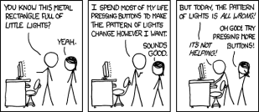
Filtering Jokes
www.xkcd.org

Slide 6

Filtering Jokes
Let the users rate the jokes
Sort by average rating

Slide 7
Collaborative Filtering
People who have agreed in the past tend to agree in the future

Slide 8

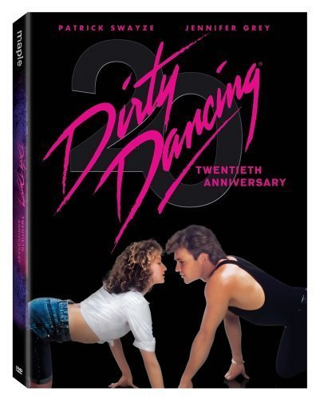
Good or Bad?
Die Hard (1988)
Dirty Dancing (1987)

Slide 9

Good or Bad?

Slide 10









Slide 11
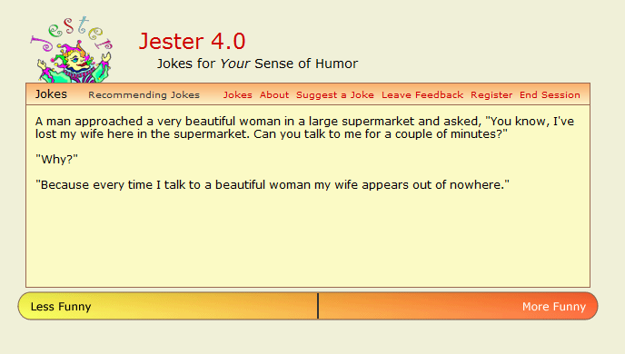
Jester 4.0 (http://eigentaste.berkeley.edu)

Slide 12
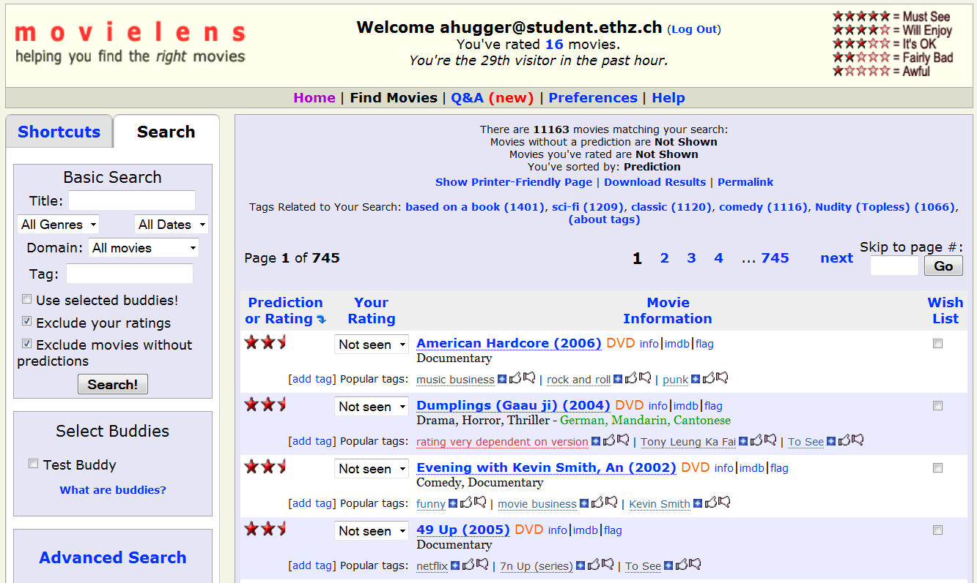
MovieLens (http://movielens.org)

Slide 13

Netflix
www.netflix.org
DVD/Blue-Ray rental and video streaming
1’000’000$ for the first beating the current recommendation algorithm by 10%
Competition started in October 2006
Ended July 2009

Slide 14
GroupLens: An Open Architecture for Collaborative Filtering of NetNews
Research paper from 1994 by:
Paul Resnick, MIT Center for Coordination Science
Neophytos Iacovou, University of Minnesota
Mitesh Suchak, MIT Center for Coordination Science
Peter Bergstrom , University of Minnesota
John Riedl , University of Minnesota

Slide 15


NetNews

Slide 16
Problems of NetNews
Signal to noise ratio is too low
Splitting bulletin board into newsgroups
Moderated newsgroups
News clients
  Summary of the author and subject line
  Display discussion threads together
  String search facilities
  Kill files

Slide 17


Modification to NetNews
2.61
3.72
Mittwoch, 28. April 2010
17

Slide 18
Predicting Scores
Score prediction system is robust to certain differences of interpretation of the rating scale
  One user rates 3-5 and the other 1-3
  One thinks 1 and the other 5 is best score

Slide 19
Predicting Scores
Predictions can be modeled as matrix filling
Item # | Ken | Lee | Meg | Nan
1 | 1 | 4 | 2 | 2
2 | 5 | 2 | 4 | 4
3 |  |  | 3
4 | 2 | 5 |  | 5
5 | 4 | 1 |  | 1
6 | ? | 2 | 5

Slide 20
Predicting Scores
Assign similarities to each of the other people
Compute over articles rated by both
Pearson Correlation Coefficients
  Between -1 and 1
= standard deviation of Ken
= average of Ken’s ratings

Slide 21
Predicting Scores
Correlation Coefficients of Ken
User | Correlation
Lee | -0.8
Meg | +1
Nan | 0
# | Ken | Lee | Meg | Nan
1 | 1 | 4 | 2 | 2
2 | 5 | 2 | 4 | 4
3 |  |  | 3
4 | 2 | 5 |  | 5
5 | 4 | 1 |  | 1
6 | ? | 2 | 5

Slide 22
Predicting Scores
Weighted average of all ratings on article 6
Ken’s prediction is 4.56
4.56

Slide 23

Scaling Issues
Relevant performance measures
  Prediction quality
  Compute time and disk storage
Rating is small, but each article may be rated by many users
Volume of ratings could exceed volume of news

Slide 24
Scaling Issues
Pre-fetching ratings and pre-computing predictions keeps user time constant
High computation complexity
Volume of all ratings may exceed the storage capacity
  100’000 users rate 10 articles per day. 100 bytes are required to store a rating. 1GB of storage required per 10 days.

Slide 25
Cluster Models

Slide 26
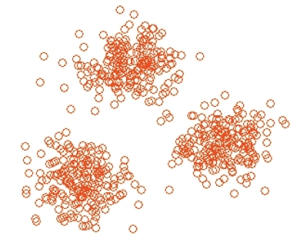
Cluster Models
Better online scalability and performance than classical collaborative filtering
Complex and extensive clustering is run offline
Prediction quality gets reduced

Slide 27

Item-to-Item Collaborative Filtering

Slide 28
Item-to-Item Collaborative Filtering
Amazon.com extensively uses recommendation algorithms
10’000’000 products and customers
Result returned in real-time (< 0.5s)
Algorithm must respond immediately to new information

Slide 29
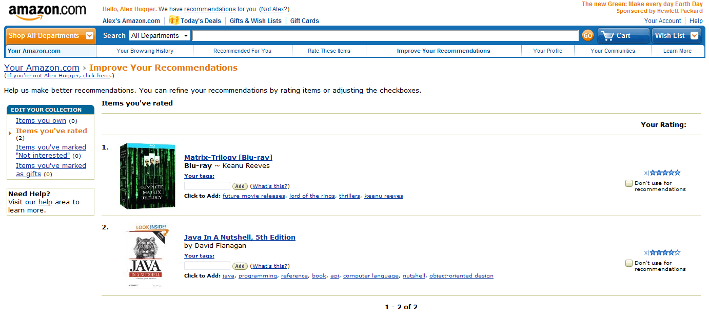
Amazon.com

Slide 30

Amazon.com

Slide 31
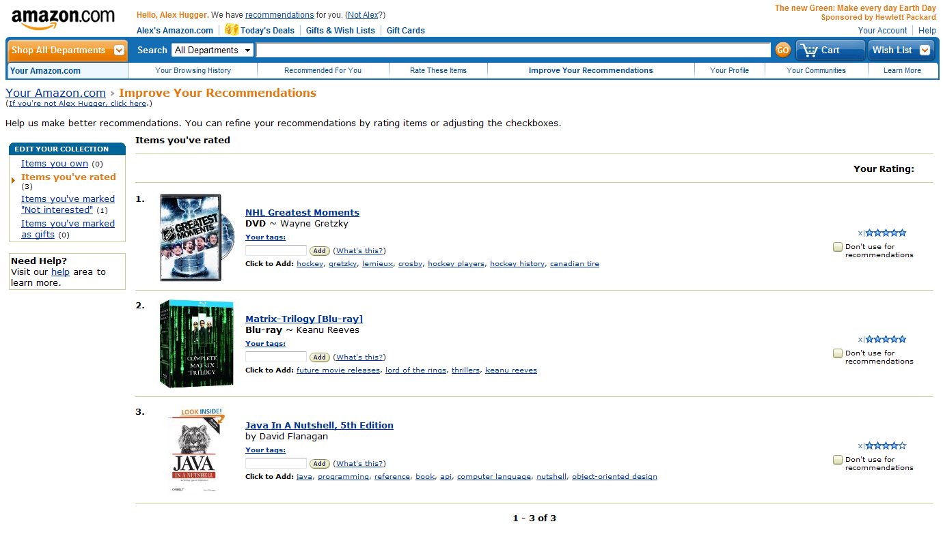
Amazon.com

Slide 32

Amazon.com

Slide 33
How It Works - Offline
Similar-items table
Calculating similarity between a single product and all related products
  Complexity: O(mn²) - in practice: O(mn)
    m: number of users
    n: number of items

Slide 34
How It Works - Online
Given a similar-items table
Find all similar items to each of the users ratings and purchases
Aggregate those items
Recommend most popular and correlated items
Number of users has no effect on performance

Slide 35
General difficulties
Cold start
Self-fulfilling prophecy
Recommendations for groups
Evaluation of recommendation systems

Slide 36
Conclusion
Effective form of targeted marketing
Mostly used in e-commerce business
  But can always be used when signal to noise ratio is too low

Slide 37
Questions?

Slide 38
References
GroupLens: An Open Architecture for Collaborative Filtering of NetNews
    Published 1994
  Paul Resnick, MIT Center for Coordination Science
  Neophytos Iacovou, University of Minnesota
  Mitesh Suchak, MIT Center for Coordination Science
  Peter Bergstrom , University of Minnesota
  John Riedl , University of Minnesota
Amazon.com Recommendations
    Published 2003
  Greg Linden
  Brent Smith
  Jeremy York

